Slide 1
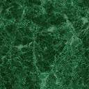
FINAL YEAR PROJECT DEFENSE ON HANDWRITTEN DIGIT RECOGNIZATION USING CONVOLUTION NEURAL NETWORK SUBMITTED TO: DEPARTMENT OF COMPUTER SCIENCE AND INFORMATION TECHNOLOGY HIMALAYA COLLEGE OF ENGINEERING
SUBMITTED BY:
Ashok Kumar Shrestha(20938/075)
Bikesh Gamal(20942/075)
Hemanta Sunuwar(20948/075)

Slide 2
INTRODUCTION
HDR is the process of identifying and classifying digits written by humans
This project is designed to recognize handwritten digits using CNN
The system will use a convolution neural network
Convolutional Neural Network is a deep learning technique to classify input automatically
HDR has been a popular research area for many years
The Flutter framework is used for the development of the mobile application
Machine learning model is trained using Python libraries such as TensorFlow.

Slide 3
PROBLEM STATEMENT
The problem is to classify handwritten digits
The challenge is to develop an algorithm or a model that can accurately identify the digits despite variations in writing styles
There are thousands of handwritten pictures to train models as a part of this problem statement
Noise and other factors can affect the appearance of HDR.

Slide 4
OBJECTIVES
To recognize digits from 0 - 9 drawn by the user and achieve correct results
To recognize images of handwritten digits uploaded by the user.

Slide 5
Scope
HDR can also be extended to recognize digits on bank cheques
HDR system can also be used to automatically sort mail based on zip code
It can also be used for signature verifications.

Slide 6
Limitations
It can only recognize a single handwritten digit
Different handwriting styles make it difficult to recognize accurately
The size and shape of digits can also affect recognition accuracy
Poor handwritten digits make recognition challenging.

Slide 7
Report Organization

Slide 8
REQUIREMENTS ANALYSIS
Functional Requirements
User should draw digits and the system will predict the respective digit
User can upload image of handwritten digit and system can predict the respective result.

Slide 9
Use Case Diagram

Slide 10
Non Functional Requirements
Performance: This system of handwritten digit recognition should be able to provide a prediction of respective handwritten digits
Scalability: The system is scalable to provide many features such as handwritten character recognition, number plate recognition, postal mail sorting, etc.
Usability: The application will have a user-friendly interface so a user should understand and use it.
Interface: This project will have a friendly user interface.
Maintainability: The system needs to be maintained. The analysis procedure in this project’s system needs to be carried out to increase the precision of the system.

Slide 11
Feasibility study
Technical feasibility: The tools and software product required to develop HDR system is available on the internet it does not require a special environment to execute it needs jupyter notebook IDE.
Operational feasibility: The user interface and resulting interface are easy to understand thus it is operationally feasible.
Economic feasibility: The system requires a python developer and flutter developer. So, the proposed system will be economically feasible

Slide 12
Class Diagram

Slide 13
Sequence Diagram

Slide 14
Activity Diagram

Slide 15
Dataset
Dataset is a collection of images or other types of data used for training and testing the network
Dataset is typically divided into two parts: a training set and a test set
Each digit is represented as a 28x28 grayscale image in dataset
Consists of a set of 70,000 28x28 grayscale images of handwritten digits

Slide 16
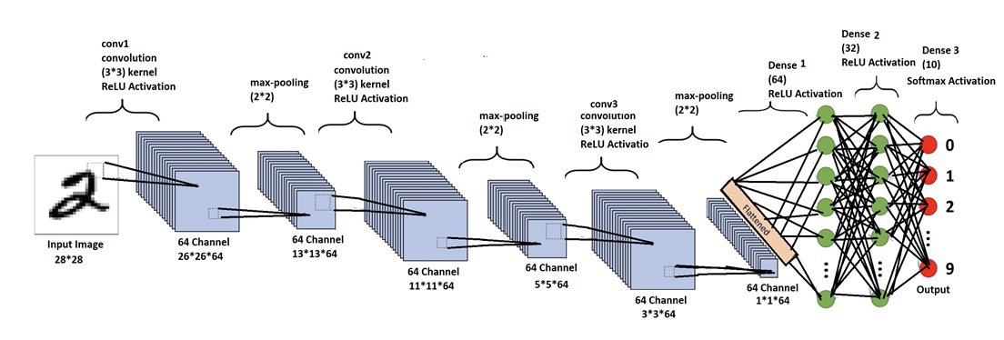
Architectural Design

Slide 17
Algorithm
Step1: Collect and prepare the dataset
Step2: Build the CNN model
2.1 Implement convolution layer
2.2 Implement Activation layer
2.3 Implement pooling layer
2.4 Implement fully-connected layer
Step 3: Train the CNN model
Step 4: Convert the model to tflite format
Step 5:Integrate the tflite model into the flutter app
Step 6: Build a user interface

Slide 18
Implementation Tools
Frontend Tools
Flutter SDK: This is the main development tool used to build the user interface and the app's front end.
Dart programming language: This is the language used to write the Flutter app's front-end code.
TensorFlow Lite: This is a lightweight version of the Tensorflow library, which can be used to run the trained CNN model on the mobile device's front end.
Canvas: This is a built-in widget in Flutter that can be used to draw the user's handwritten digits on the screen.

Slide 19
Implementation tools
Backend Tools
Python: This is the main programming language used to build the CNN model for digit recognition.
Keras: These are popular deep-learning frameworks that can be used to build and train the CNN model.

Slide 20
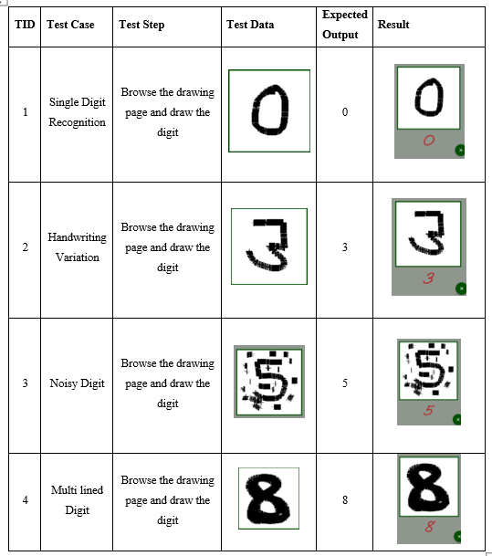
Testing

Slide 21
Conclusion and Future Recommendation
Conclusion
Building a handwritten digit recognition system using CNN in flutter is a complex task that involves both front-end development and back-end development
Overall building a handwritten digit using CNN in flutter requires a combination of machine learning and mobile app development skill.

Slide 22
Conclusion and Future Recommendation
Future recommendation
This handwritten digit recognition can be expanded to recognize multiple digits at once
Handwritten digit recognition can be expanded to recognize the digits written in multiple languages.
integrated with another technology like a character recognizer to help in identifying the number plates of the vehicle

Slide 23

Demo video

Slide 24
THANK YOU FOR YOUR ATTENTION

